Slide 1

The R Course for Analysts
Lesson 6: Reading, Writing and Wrangling Data in the Tidyverse

Slide 2
References & Texts
I recommend the following resources, which I have made copious use of in developing this material:
Arendt, C. (2020). The xlsx package. https://www.rdocumentation.org/packages/xlsx/versions/0.6.5
Garrett Grolemund
Hands On Programming in R
O'Reilly and Associates, 2014 http://bit.ly/HandsOnR
Hadley Wickham & Garrett Grolemund
R for Data Science
O'Reilly and Associates, 2017 Freely accessible here: https://r4ds.had.co.nz/index.html
Wickham, H. Tidyverse: R Packages for Data Science https://www.tidyverse.org/

Slide 3
Tidyverse review
The Tidyverse, a collection of R packages written by Hadley Wickham, designed for data science. All packages share an underlying design philosophy, grammar, and data structures and facilitate string manipulation, feature creation, data wrangling, and other important data-related tasks.
Much of the growing popularity of the R language is related to the elegance and reusability of Tidyverse code, and the solid foundation it has created for additional user-created R packages for data science and statistics.
The packages included in The Tidyverse are:
readr: a fast and friendly way to read rectangular data (like csv, tsv, and fwf); designed to flexibly parse many types of data
purrr: enhances R’s functional programming (FP) toolkit by providing a complete and consistent set of tools for working with functions and vectors
stringr: a cohesive set of functions designed to make working with strings easier
tibble: a modern re-imagining of the data frame
tidyr: a set of functions that help you get data with a consistent form with every variable in a column, and every column a variable
forcats: provides a suite of useful tools that solve common problems with factors / categorical variables
dplyr: solves the most common data wrangling and manipulation challenges
ggplot2: a system for creating graphics and data visualizations

Slide 4
Reading and Writing Data Files

Slide 5
library(tidyverse)
From readr:
read_csv() and read_csv2() for csv files
read_tsv() for tab-separated files
read_fwf() for fixed-width files
read_log() for web log files
For writing: write_csv(), write_csv2(), write_excel_csv(),
write_excel_csv2(), write_tsv(), and write_delim()
From the Haven package (also part of tidyverse):
read_sas() reads .sas7bdat + .sas7bcat files and
read_xpt() reads SAS transport files (version 5 and version 8)
read_sav() reads .sav files and
read_por() reads the older .por files
write_sav() writes .sav files
read_dta() reads .dta files (up to version 15).
write_dta() writes .dta files (versions 8-15).
library(xlsx)
read_xlsx() and read_xlsx2() for excel files
write_xlsx()
Reading and Writing Data Files
Access to readr and Haven libraries is easy. All you need is to include the library(tidyverse) at the beginning of your file, to include all of the tidyverse libraries!
From there, you can call all the readr and/or Haven functions to read your data files into a data frame or tibble!
For excel files, you need the library(xlsx).

Slide 6
# Examples: reading in data
spending <- read_csv("SomeSpending.csv", col_names=TRUE, quote = "`")
spec(spending)
Rows: 15 Columns: 5
-- Column specification -------------------------------------------------------------------------------
Delimiter: \cols(
date = col_character(),
amount = col_double(),
item = col_double(),
desc = col_character(),
cat = col_character()
)
# Giving the parser clearer instructions:
spending <- read_csv(
"SomeSpending.csv",
col_types = list(
date = col_date(format = "%m/%d/%Y"),
amount = col_double(),
item = col_integer(),
desc = col_character(),
cat = col_factor()
)
)
spec(spending)
cols(
date = col_date(format = "%m/%d/%Y"),
amount = col_double(),
item = col_integer(),
desc = col_character(),
cat = col_factor(levels = NULL, ordered = FALSE, include_na = FALSE)
)
Examples: reading in data files
Reading in a csv file:
Store the data in a data frame / tibble, "spending"
col_names argument is TRUE, if the first row of the file contains column headers / names. (default value)
Quote is the character used to quote text fields, this can be handy if you have large text fields that might contain formatting (carriage returns, form feeds or line breaks) or non-standard characters for your locale. I used the backtick (`), but the tilde (~) is another good option.
The spec() command: tells us how the parser guessed field types
Here, spec() tells us the parser guessed the file was comma-delimited (correct!), but it thought our 'date' field was a character field, and 'item’ was a double, rather than an integer. The other fields are typed correctly, although the 'cat' field contains a string that should be treated as a category or factor. We can change the code that reads the file so the parser will choose types correctly.

Slide 7
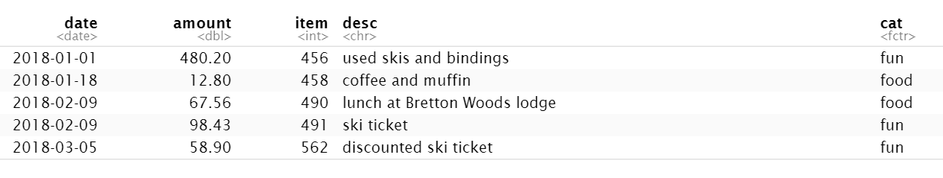
# Spec() Before Read
# Calling spec() before loading the file (same file, this time in tab-delimited
# text format)
spec_tsv("SomeSpending.txt", col_names = TRUE)
---------- OUTPUT -----------
cols(
date = col_character(),
amount = col_double(),
item = col_double(),
desc = col_character(),
cat = col_character()
)
# Now, load the file with the correct data types:
spending_txt <- read_tsv(
"SomeSpending.txt",
col_types = list(
date = col_date(format = "%m/%d/%Y"),
amount = col_double(),
item = col_integer(),
desc = col_character(),
cat = col_factor()
)
)
# Show the first five rows of the tibble data frame
head(spending_txt, 5)
---------- OUTPUT ---------→
Spec() before Read
We don't have to load a file to look at its spec(). This is really handy when we want to see how readr will parse a file before we load it!
That way, we can make the formatting changes we want in the first readr call.

Slide 8
# Examples: reading in an Excel file with library(xlsx)
# Loading an Excel version of the file
# The basic version, using sheetIndex to specify the sheet:
excel_spending <- read.xlsx("SomeSpending.xlsx", sheetIndex = 1)
# The xlsx library DOES NOT create a tibble (special tidyverse data.frame)
# Instead, it creates an old-fashioned R data.frame object
# To see its structure and data types, we use the str() command
str(excel_spending)
---------------- OUTPUT ----------------
'data.frame': 15 obs. of 5 variables:
$ date : Date, format: "2018-01-01" "2018-01-18" "2018-02-09" "2018-02-09" ...
$ amount: num 480.2 12.8 67.6 98.4 58.9 ...
$ item : num 456 458 490 491 562 ...
$ desc : chr "used skis and bindings" "coffee and muffin" "lunch at Bretton Woods lodge" "ski ticket" ...
$ cat : chr "fun" "food" "food" "fun" ...
# Convert the 'cat' column to a categorical variable:
excel_spending$cat <- as.factor(excel_spending$cat)
str(excel_spending)
---------------- OUTPUT ----------------
'data.frame': 15 obs. of 5 variables:
$ date : Date, format: "2018-01-01" "2018-01-18" "2018-02-09" "2018-02-09" ...
$ amount: num 480.2 12.8 67.6 98.4 58.9 ...
$ item : num 456 458 490 491 562 ...
$ desc : chr "used skis and bindings" "coffee and muffin" "lunch at Bretton Woods lodge" "ski ticket" ...
$ cat : Factor w/ 6 levels "clothing","food",..: 3 2 2 3 3 5 1 3 3 2 ...
Working with Excel Files
The xlsx library is NOT part of the tidyverse.
It is a powerful library for working with Excel documents and can do lots of very cool things:
However, when we read in documents with the xlsx library, we have to interact with them as REGULAR R DATA FRAMES (not as tibbles)!
To get the ‘spec’ of a regular R data frame, use the str() command.
You can see that xlsx picked a lot of the right data types, including detecting our ‘date’ column! However, we still need to change ‘cat’ to a categorical variable. To do this in ‘regular’ R, we use the as.factor() command.

Slide 9

Working with other file-types: the Haven package
There are lots of other file-types you might want to work with.
There are many great R libraries maintained for this purpose!
One of the most popular, which is part of the tidyverse, is the Haven package
https://haven.tidyverse.org/
Haven allows you to work in R with:
SAS files
Stata files
SPSS files
The syntax for these commands will be very much like what you’ve already seen with .csv and .txt (tab-delimited) files on slides 6 & 7.

Slide 10


Introducing tidy data, and dplyr
The powerful dplyr library allows us to operate on tibbles!
For a detailed discussion about how, exactly, tibbles differ from data frames, read here:
https://www.r-bloggers.com/2020/05/create-and-convert-tibbles/
We’ll be focusing on the 5 most common, most important dplyr functions throughout the remainder of this lesson:
filter() - pick observations from the data set
arrange() - reorder the rows
select() - pick variables by their names
mutate() - create new variables with functions of existing variables
summarize() - collapse many values down to a summary / aggregate
We’ll also discuss the topic of tidy data – what it is, and how to create it.

Slide 11
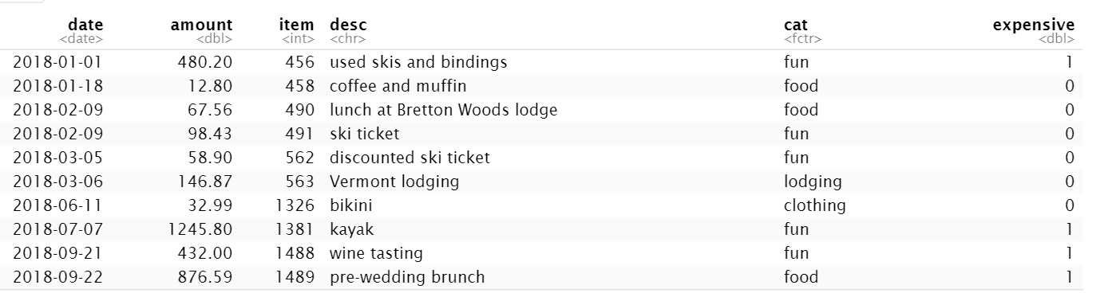
Gently introducing the mutate() function
# Using dplyr's mutate function to create a new column called # "expensive" based on the value of "amount"
spending <- spending %>%
mutate(expensive = ifelse(amount > 300, 1, 0))
# Spending tibble with new column, 'expensive'
print(spending)
Now that we’ve read in our ‘spending’ tibble, let’s begin to introduce the mutate() function, by creating a new variable, ‘expensive’, using an existing variable, ‘amount’.
When working with dplyr functions, you can either:
Pass the tibble as an argument
OR use the %>% pipe operator
NOTE: Here, I’m using the ifelse() function to create the new variable, but if you have more than 2 options you can use case_when() instead: https://www.statology.org/conditional-mutating-r/
This is the first exposure to mutate() – don’t worry, there will be others!

Slide 12
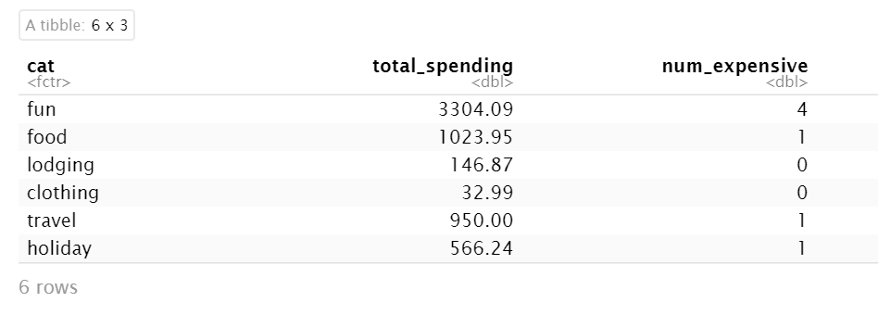
First summarize()
# Using dplyr’s group_by() and summarize() to create a new tibble with basic
# summary statistics:
cat_spending_summary <- spending %>%
group_by(cat) %>%
summarise(sum(amount), sum(expensive))
# Assigning column names to our new tibble
colnames(cat_spending_summary) <- c("cat", "total_spending", "num_expensive")
print(cat_spending_summary)
Now, we can also use dplyr to easily summarize the most expensive categories in our ‘spending’ tibble.
First, we pass the tibble to the group_by() function using the %>% pipe operator to arrange it by category, then we pass the output to summarize() to aggregate the “amount” and “expensive” columns using sum(), giving us a new tibble with the total amounts and # of expensive purchases by category.
This small snippet of code is an introduction to dplyr's power.

Slide 13
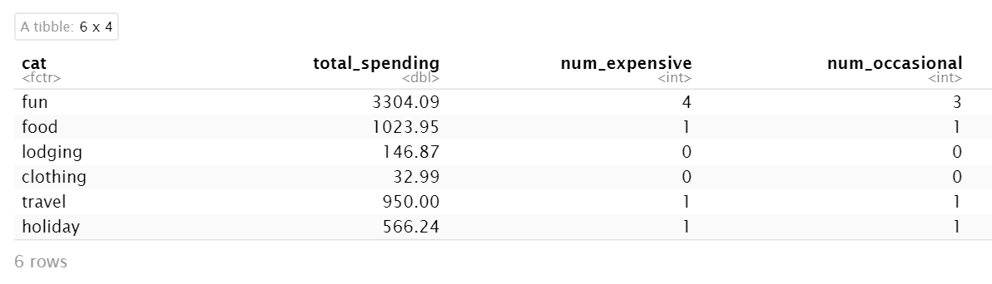
Adding a new column, and creating a new summary
# Using old-fashioned assignment to create a new column (also works # on data.frames)
spending$occasional <- c(1, 0, 0, 0, 0, 0, 0, 1, 0, 1, 1, 0, 1, 0, 1)
# And, re-summarize:
cat_spending_summary <- spending %>%
group_by(cat) %>%
summarise(sum(amount), sum(expensive), sum(occasional))
colnames(cat_spending_summary) <- c("cat", "total_spending", "num_expensive", "num_occasional")
print(cat_spending_summary)
Our friend sure knows how to party, but might be spending a little too much on fun.
Still, what about annual or one-time purchases? Those aren't as repetitive, so a few of them isn't the worst.
Let's add another column for those.
This time, we'll have to scrutinize each entry to decide whether or not the label applies.
6/7ths (86%) of our friend’s expensive purchases are infrequent!

Slide 14
Writing our tibbles to csv and Excel files
Writing 'spending' to a csv file using readr (can work directly with the tibble):
write_csv(spending, "SomeSpending2.csv")
Writing 'spending' to an Excel file, and 'cat_spending_summary' to the second sheet
In this case, we first have to create data.frame versions of our tibbles
spending_df <- as.data.frame(spending)
cat_spending_summary_df <- as.data.frame(cat_spending_summary)
write.xlsx(spending_df,
file = "SomeSpending2.xlsx",
sheetName = "All Data",
row.names = FALSE, # don't save the row names, they're just numbers
append = FALSE)
Add the second data set as Sheet 2 (now, append must be = TRUE):
write.xlsx(cat_spending_summary_df,
file = "SomeSpending2.xlsx",
sheetName = "By Category",
row.names = FALSE,
append = TRUE)

Slide 15
Tidy data and dplyr

Slide 16
Tidy data
What is 'tidy' data?
- Each variable should have its own column
- Each observation should have its own row
- Each value should have its own cell
In the tidyverse, data like this is easier to work with. This is different from the data shape most preferred by, for example, Power BI.
Why do this? Because R works natively on vectors of information.
Placing variables in columns allows R's ability to perform vector operations to be well-utilized (Wickham & Grolemund, p. 150)

Slide 17
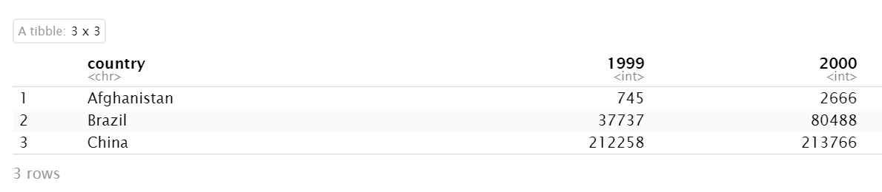
Making data tidy: spread, gather, separate and unite
The data below is accessible once you’ve included library(tidyverse) as table4a:
How can we make this data tidy?

Slide 18
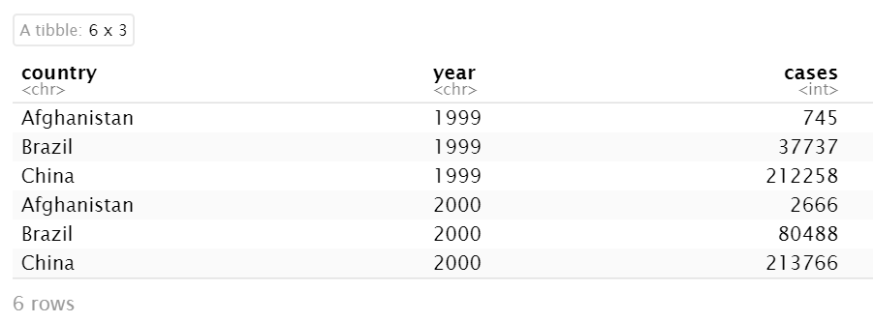
Using gather()
If we want the table4a data to be tidy, we want the years to be in their own column.
This is called 'gathering', and it takes 3 parameters:
the columns that represent values, instead of variables
the name of the variable whose values form the column names, and
the name of the variable whose values are spread over the cells
Note that when referring to column names of a tibble that are NOT legit R variable names, we must enclose the names in backticks: ``
tidy_4a <- table4a %>%
gather(`1999`, `2000`, key = "year", value = "cases")

Slide 19
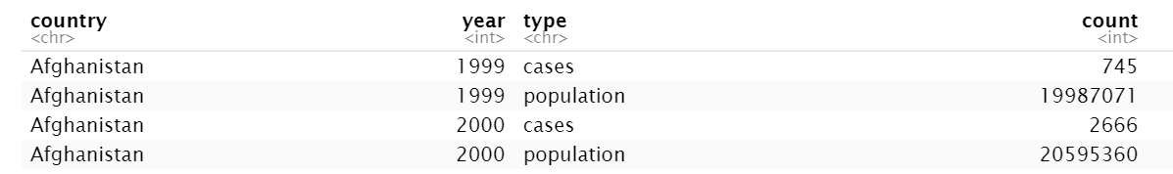
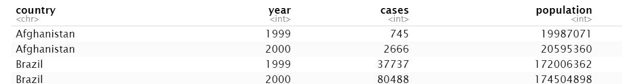
Spread() – the opposite of gather
Used when an observation is scattered among multiple rows.
Below is table2, where we have repeating rows for years, cases and population.
If the data were tidy, cases would be in one column, and population would be in another:
table2 %>%
spread(key = type, value = count)
Before spread():
After spread():

Slide 20
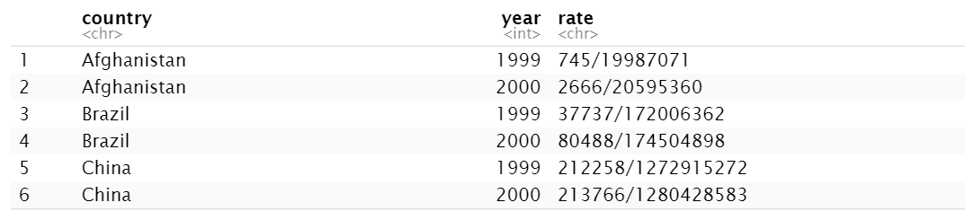
Separating and uniting data
Sometimes data is squished together into one column when it should really be in more than one.
We can separate it with the separate() function.
Other times, we prefer to bring together data that is separated into individual columns.
This is done using unite().
Below is table3. Instead of cases/population in the ‘rate’ field, we want to divide this field on the ‘/’ into cases and population fields, and then use mutate() to add a calculated ‘rate’ field.

Slide 21
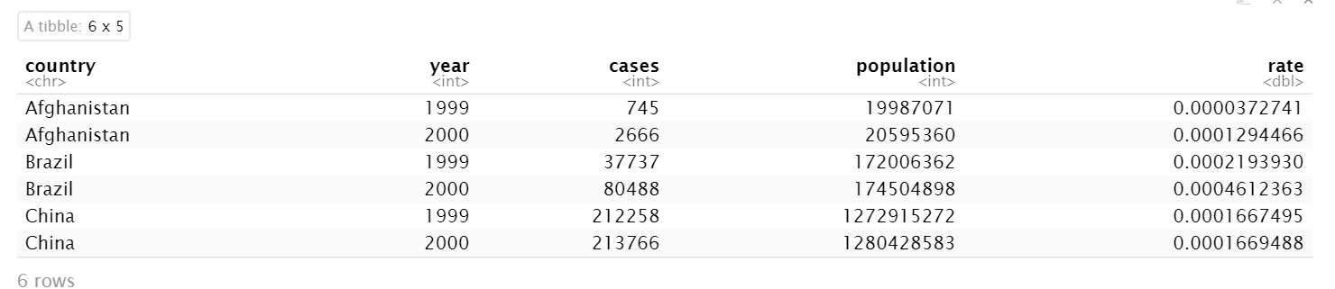
Below, we operate on table2 to separate() rate into cases and population, then, use mutate() to
calculate the rate field.
Here, we must use convert=TRUE, so that 'cases' and 'population' will be converted to numbers!
If we don't, the mutate line will cause an error, since trying to divide strings is not a defined
operation.
tidy_table3 <- table3 %>%
separate(rate, into = c("cases", "population"), convert = TRUE) %>%
mutate(rate = cases/population)
print(tidy_table3)

Slide 22
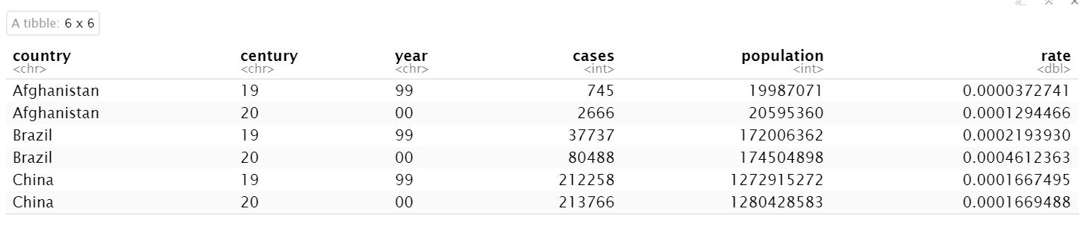
We can also separate() table2’s ‘year’ column into ‘century’ and ‘year’.
By default, separate() splits when it sees a non-alpha numeric character, but we could also specify the character to split on, with – for example – separate(rate, into = c("cases", "population"), sep="/").
Here, we’ll use sep = index position to divide the year column in two, splitting the year between the 2nd and 3rd digits:
less_tidy3 <- tidy_table3 %>%
separate(year, into = c("century", "year"), sep = 2)
print(less_tidy3)

Slide 23
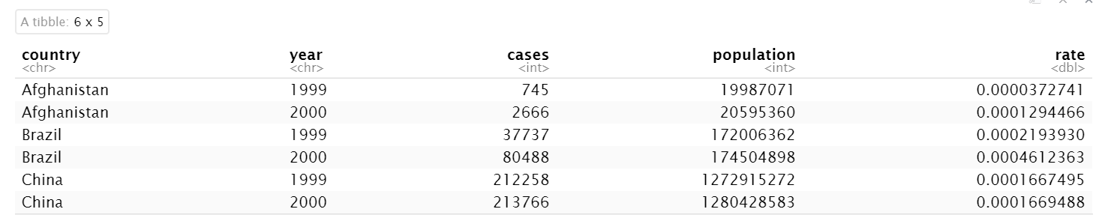
Unite() – opposite of separate
Putting the tibble we just created back together:
reunited_table3 <- less_tidy3 %>%
unite("year", century, year, sep = "")
reunited_table3
Default value for sep is _.
NOTE: If you wanted to keep both the input columns and the new column, set remove argument to FALSE:

Slide 24
A review of joins
Just like in SQL, you can join tables together in the tidyverse, using dplyr.
Hadley Wickham classifies them into three categories:
Mutating joins: add new variables to one data frame from matching observations in another
Filtering joins: filter observations from one data frame based on whether or not they appear in the other
Set operations: treat observations as if they were elements in a set (rarely used)

Slide 25
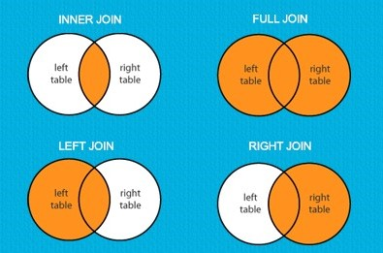
Join rules
When joining table X to table Y:
An inner join keeps only the rows X and Y have in common.
A left join keeps all of the rows in X, and adds only the data in Y where rows in Y have commonality with X.
A right join keeps all of the rows in Y, and adds only the data in X where rows in X have commonality with Y.
A full join keeps all the rows in both X and Y, and fills in the value NULL or NA where a row from X has no match in Y, or a row from Y has no match in X.

Slide 26
“Natural” joins
In dplyr, joining two tibble or data frame objects together can be done without specifying the variables to join on.
This is called a ‘natural’ join, because dplyr will look in both tables for variables / columns in common, and join on any commonalities.
For instance, in the nycflights13 data set, accessible with library(nycflights13), this joins the flights data table to the weather data table on their common variables (origin and year, month, day and hour):
flights %>%
left_join(weather)
In general, natural joins are NOT a good idea! It is better to specify the specific columns to join on, because many tables contain columns or variables with the same names that contain very different information.
Flights %>%
left_join(planes, by = "tailnum")

Slide 27
Filtering joins
Filtering joins exclude some rows:
semi_join(x, y) keeps all observations in x that have a match in y
anti_join(x, y) drops all observations in x that have a match in y
top_dests <- flights %>%
count(dest, sort = TRUE) %>%
head(10)
# Flights that went to the top_dests
flights %>%
semi_join(top_dests)
# Flights with NO MATCH in planes
flights %>%
anti_join(planes, by = "tailnum") %>%
count(tailnum, sort = TRUE)

Slide 28
Core dplyr
There are five core dplyr functions that every R user must know:
filter() - pick observations from the data set
arrange() - reorder the rows
select() - pick variables by their names
mutate() - create new variables with functions of existing variables
summarize() - collapse many values down to a summary / aggregate
We’ve already used mutate and summarize(), but now we’ll systematically introduce each of these important functions, so afterwards, we can use them all together in a single practice exercise!

Slide 29
Homework – Lesson 6
Reading and Writing Files; Using dplyr and tidyr for Data Wrangling
Review the companion R notebooks for this lesson, “Reading and Writing Data Files”, and “Manipulating Data with dplyr”.
Complete the following activity using the Lesson 6 Homework Template.Rmd file and P2-movie-ratings.csv file
I. CSV to Excel
Read in the P2-movie-ratings.csv file
Look at how the data types were parsed either before or after you read the file into a tibble
Revise the file data types as follows:
Film, chr
Genre, factor / category
Ratings %s, Budget and Year of Release, int
Call the summary function on the int columns
Determine the 75th percentile for the Audience Rating %, and create a new column, `Highly Rated`, which is 1 when Audience Rating % is > 75th percentile, and 0 when it isn’t.
Group the data by Genre, and Summarize it to include the mean ratings for each Genre, followed by the total # of `Highly Rated` films
Arrange the data in a logical manner and re-name the colnames of the aggregated tibble so they are easy to read and understand
Convert the original revised tibble and summarized tibble to data frames
Write the data frames to an Excel document, P2-movie-ratings.xlsx, as Sheet 1 and Sheet 2
Wrangling the language_diversity Data Set
Install the ‘untidydata’ library using the following command: devtools::install_github("jvcasillas/untidydata")
Tidy the language_diversity data set by spreading the data in the Measurement and Value columns into the following columns: Languages, Area, Population, Stations, MGS, and Std
Create a new tibble by Selecting columns except MGS and Std
Cast the Continent column as a factor
Filter the tibble to only Asian countries
Mutate to create a new column, `Language Rate` that contains languages per area
Group the data by country and arrange it by Area
Summarize each country by min, mean and max of `Language Rate` to see which countries in Asia have the most languages per area
Write the new summarized data set to a .csv file using write_csv (the readr function that works with tibbles)

